Slide 1
Use Cases, requirements and reference framework
-Standalone Service ID in Routing Network
Daniel Huang, ZTE Corporation
Jie Liang, China Telecom
Feng Yang, China Mobile
Yan Zhang, China Unicom
Dong Yang，Beijing Jiaotong University
IETF-119, Mar 2024

Slide 2
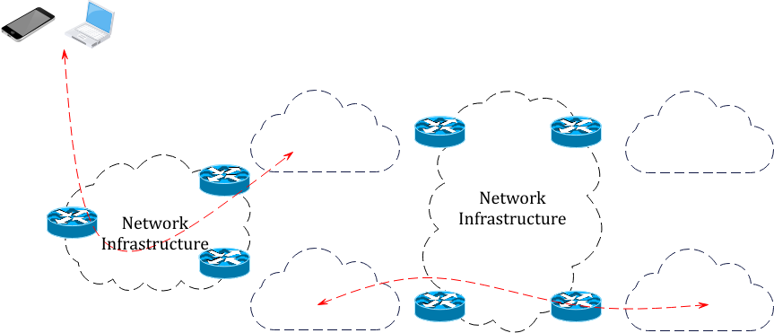
Apps and service diversity, coordination among micro-services
North-South Traffic
East-West Traffic
Connectivity: fine-grained beyond “Best effort”
Scheduling: coordination between networking and computing
Observability: service-oriented, whole-stack
Notes:
north-south traffic需要加入一个手机，表示用户发出的

Slide 3
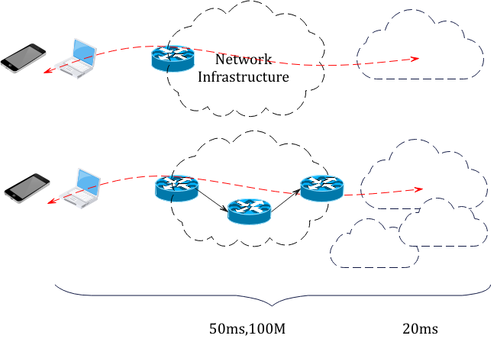
Gaps of south-north traffic scenario
Connectivity: Without explict interface between the service and the differentiated networking capabilities
Scheduling: The network steers traffic without service status, and the service delivers the traffic without network status, while actually both need to align with each other.
Observability : whole-stack and end2end view of the service performance could not be collected under existing mechanisms

Slide 4
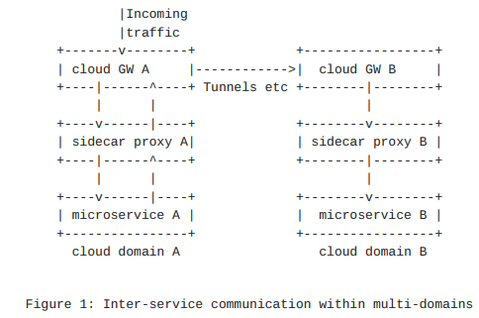
Gateways and proxies in the way of east-west traffic
Additional processing delay at the gateways for each hop service-to-service communication
---> Large end-to-end delay
Interfaces are needed to establish appropriate mapping between different technologies in two adjacent domains
---> High management complexity: a lot of static mapping configurations
a proxy intercept traffic and conduct processing
application semantics are considered
consists of three TCP segments

Slide 5
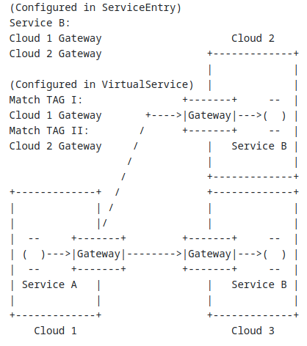
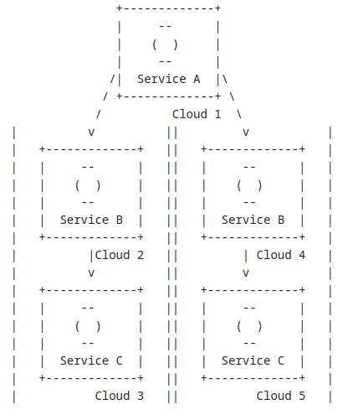
Cross registries and isolations from service interconnections
3. Collaborative logic across microservices and endpoints is not perceived and maintained by infrastructure.
1. Static configs for both service discovery and scheduling policies
2. The service endpoints are not aware of the resources and circumstances of network capabilities

Slide 6
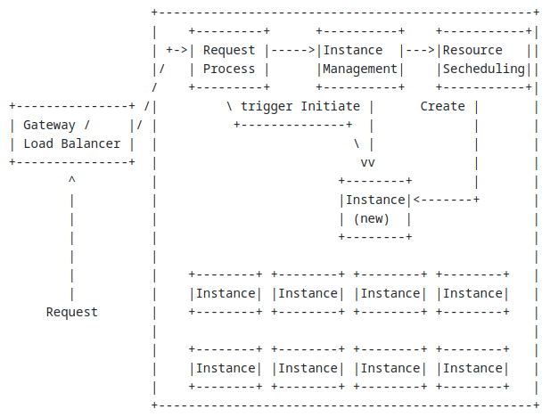
Limited resources and burdening configs in edge site scheduling
1. End systems and edge sites initiate the service request without whole picture status of the remote sites. The status gap matters significantly in the case of serverless.
2. Difficulties and burdens in managing instances with dynamic scaling conditions in control plane.

Slide 7
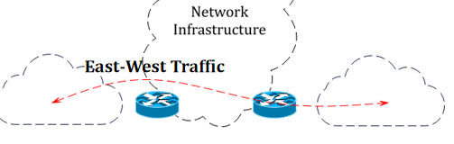
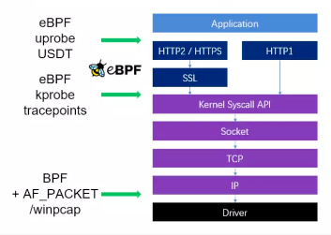
Blind spots in APM and eBPF
Enhanced Berkeley Packet Filter (eBPF) technologies
the byte streams collected by the eBPF technologies pertains to process and thread, and it is difficult to associate with the services and applications.
Unable to correlate the failure in the underlay network with the overlay tunnel and take action in a timely manner.
Blind spots
Application Performance Management (APM)
When it comes to different scheduling polices with regard to either networking or services , APM is either not allowed or leads to maintenance difficulties such as conflicts of codes
Unable to obtain measurements regarding the infrastructure such as system calls and network transmissions
source: https://deepflow.io/blog/039-qcon-2022-in-depth-practice-of-cloud-native-observability-based-on-ebpf/

Slide 8
Requirements of standalone service ID in routing network
Location/Device independant
User
independant
Interface to the third parties
Interface to the capabilities
Service type and nothing more
Terminology: we do not believe “service ID” is the best and it remains open for better suggestions.

Slide 9
Preliminary reference framework
Service ID governance system
Service ID for multi-entity
S-ID in L4
S-ID in L4
S-ID in L3
S-ID sub-ayer
S-ID sub-ayer
S-ID sub-ayer
S-ID sub-ayer
S-ID in L3
Underlay
Underlay
Underlay
Underlay
Service Point
SSR ingress 1
SSR egress 1
SSR ingress 2
SSR egress 2
Service Point
AS1
AS2
1.Employment of standalone service ID in L3 network creates a virtual service ID sub-layer.
2.The service ID could be managed independently in different administrative domains while seamlessly mapping with each other.
3.The service point could be end user terminal, CPE, app gateway and service proxy.

